Slide 1

Android UI Patterns
by
Peter Pascale, Vladan Pulec

Slide 2

Agenda
Android UI History
Android 4 UI Highlights
Android UI Patterns

Slide 3
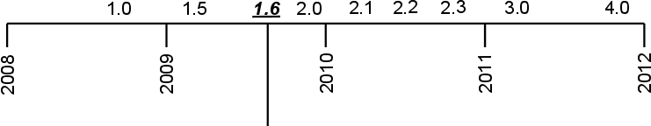
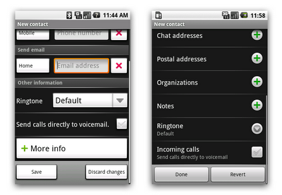
Android Version History
Look and Feel
Formalized
2009

Slide 4
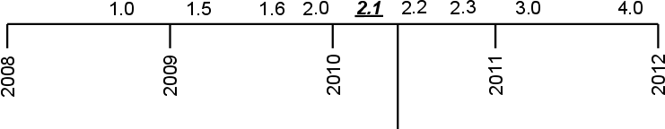
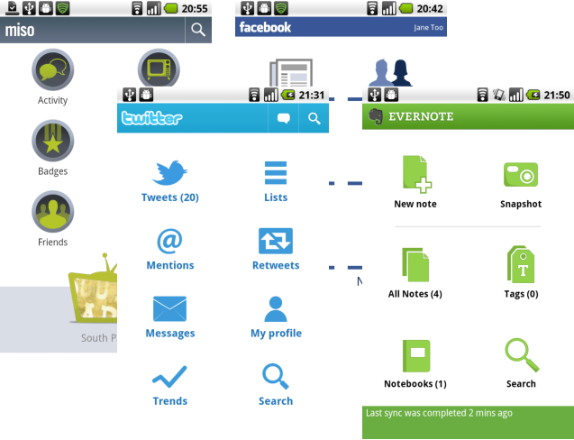
Android Version History
2010 Google IO
Dashboard UI Pattern

Slide 5
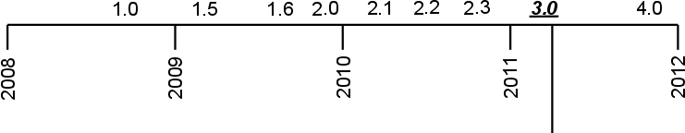
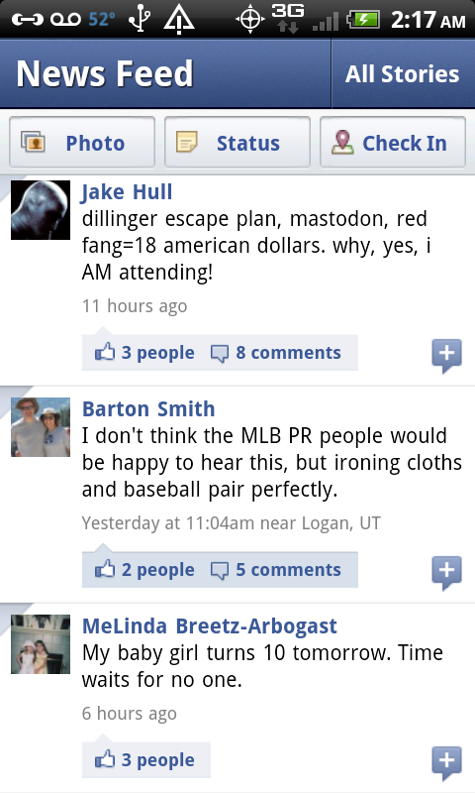
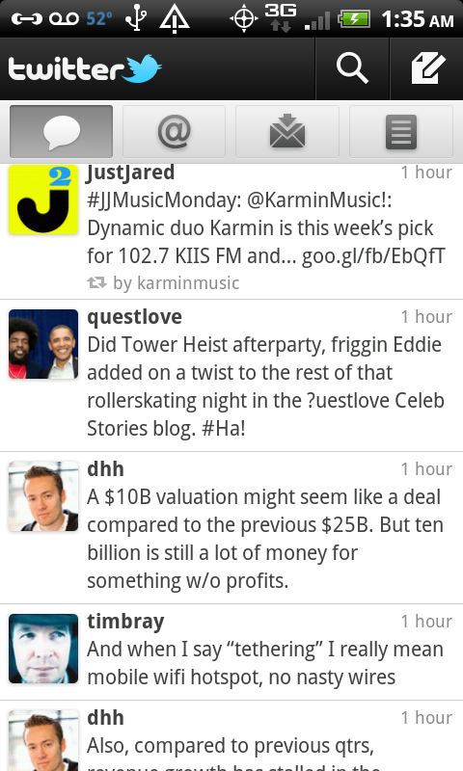
Android Version History
2011 Google IO
Tablet Patterns
No More
Dashboard

Slide 6
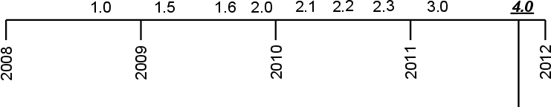
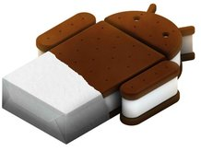
Android Version History
Ice Cream Sandwich
October 19 2010
Honeycomb UI - Unification
No More Hardware Buttons

Slide 7
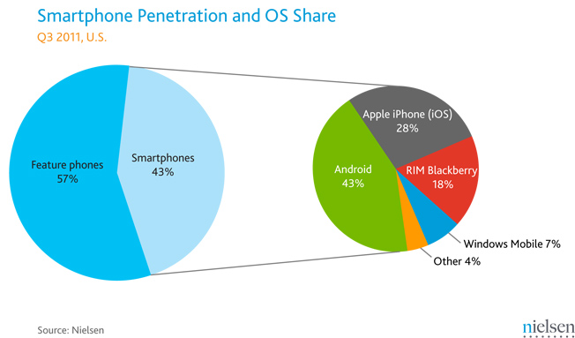
Android Market Share

Slide 8
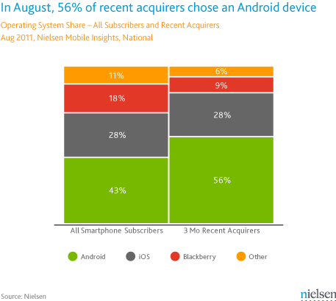
Android Market Share

Slide 9
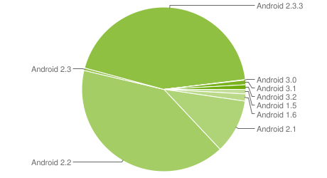
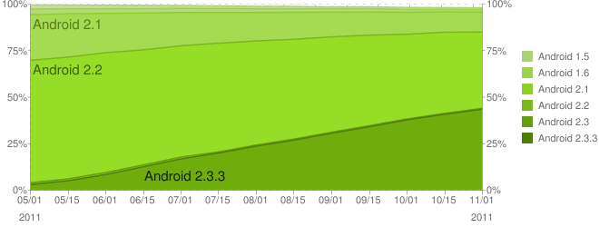
Android Versions - Reality
Source: developer.android.com
As of November 3, 2011

Slide 10
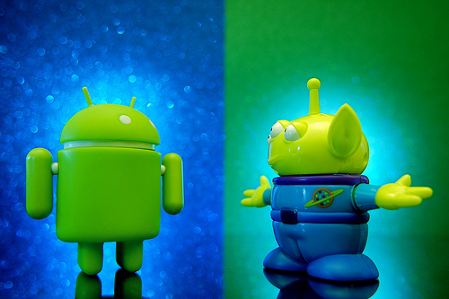
UI Design Pattern Goals

Slide 11

UI Design Goals Related to Patterns
Stay Consistent
Use Visual Hierarchy
Value Simplicity
Pay Attention to Patterns

Slide 12
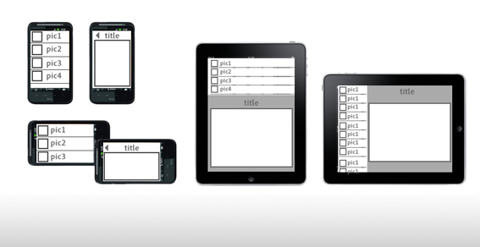
Tablet vs. Phone User Experience
Users hold and interact with phones and tablets differently
UI needs to be adaptive to support user interaction

Slide 13

Android 4.0 UI Features
Simplified Look and Feel
Unified Tablet/Phone Platform
System Bar and Action Bar
Virtual Navigation Buttons
No Hardware Buttons

Slide 14

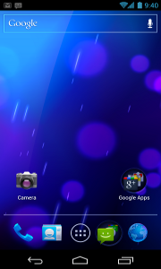



Navigation in Android 4.0
Software Navigation Buttons
System Back
System Home
Recents
No Search or Menu

Slide 15
Android UI Patterns
Action Bar
Multi-Pane Layout
Carousel
Quick Actions
Dashboard
Workspaces

Slide 16
Action Bar
Multi-Pane Layout
Carousel
Quick Actions
Dashboard
Workspaces

Slide 17

Action Bar
Dedicated Real Estate at the Top of Each Screen
Make Frequent Actions Prominent
Support Navigation
Indicate Current Location in App
Consistent Between Tablets and Phones
Provide Branding

Slide 18

Action Bar - Sections
Where am I?
application icon or logo
can be used for "upward" navigation

Slide 19

Action Bar - Sections
What can I see?
view details
(can have a navigation component)
can include tabs, dropdowns, breadcrumbs

Slide 20

Action Bar - Sections
What can I do?
action buttons (icons, text, or both)
most important or frequently used actions
new place for Search and Menu

Slide 21
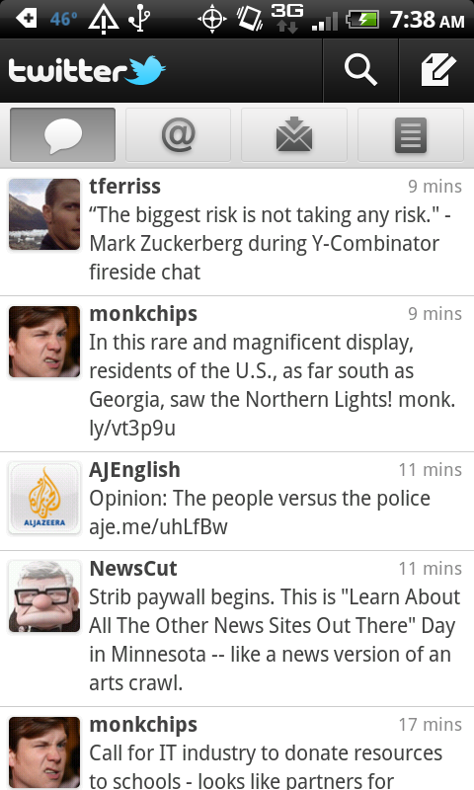
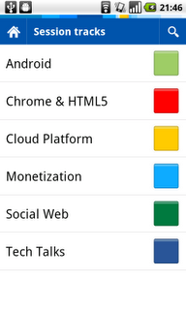
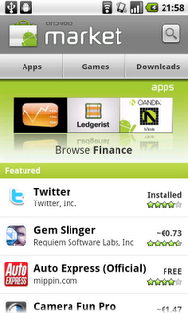
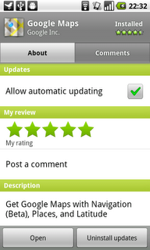
Action Bar - Examples

Slide 22
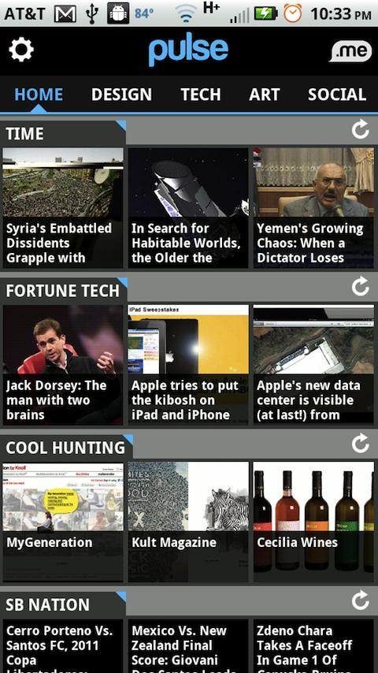
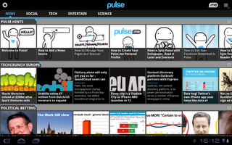
Action Bar Consistency Between Phone and Tablet

Slide 23
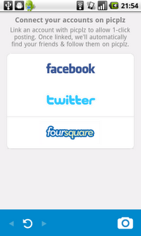
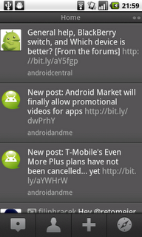
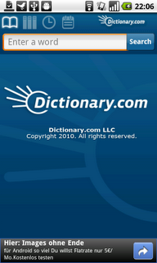
Action Bar - Antipatterns
Ignoring the "Where - See - Do" Best Practice
Button controls at the bottom of the screen
Inconsistent across different applications

Slide 24
ActionBar Code Demo

Slide 25
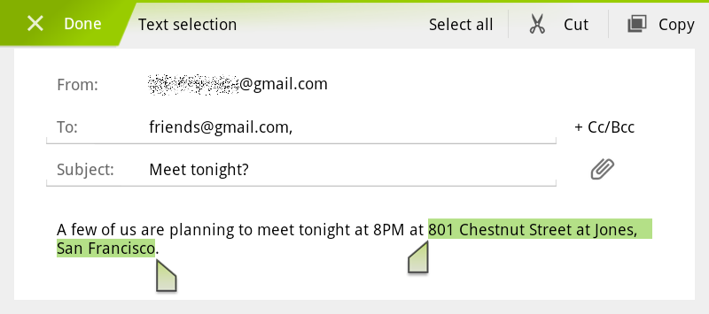
Action Bar - Summary
Replaces traditional title bar
Makes frequently used actions prominent
Convenient means of handling menu and search
Dedicated, persistent real estate
Displays application icon together with the activity title

Slide 26
Action Bar
Multi-Pane Layout
Carousel
Quick Actions
Dashboard
Workspaces
Notes:
Peter

Slide 27
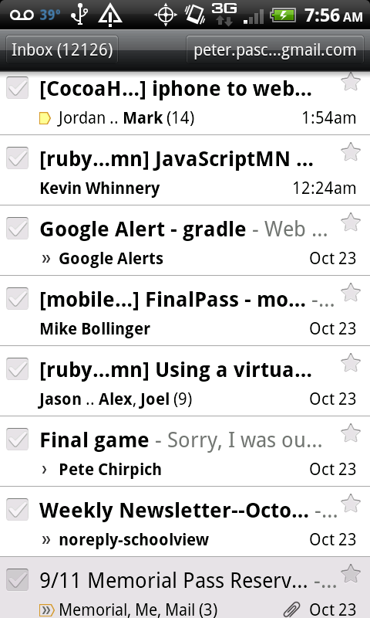
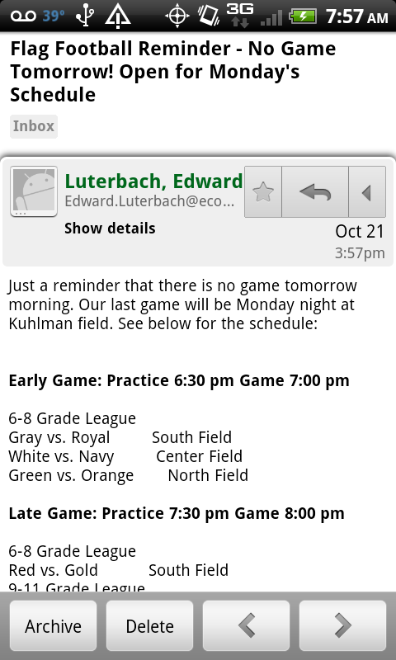
Multi-Pane Layout
Notes:
Peter
Take Advantage of Tablet Real Estate
Consolidate Multiple Phone Screens into One Layout
Master - Detail

Slide 28
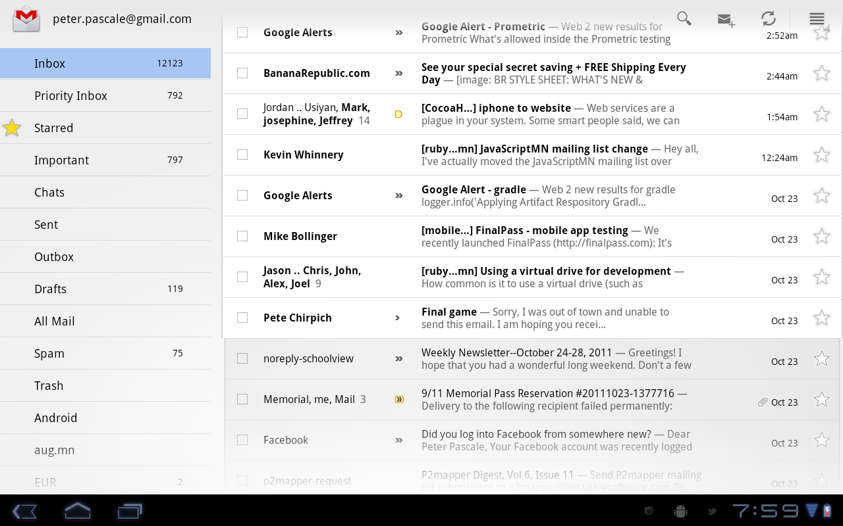
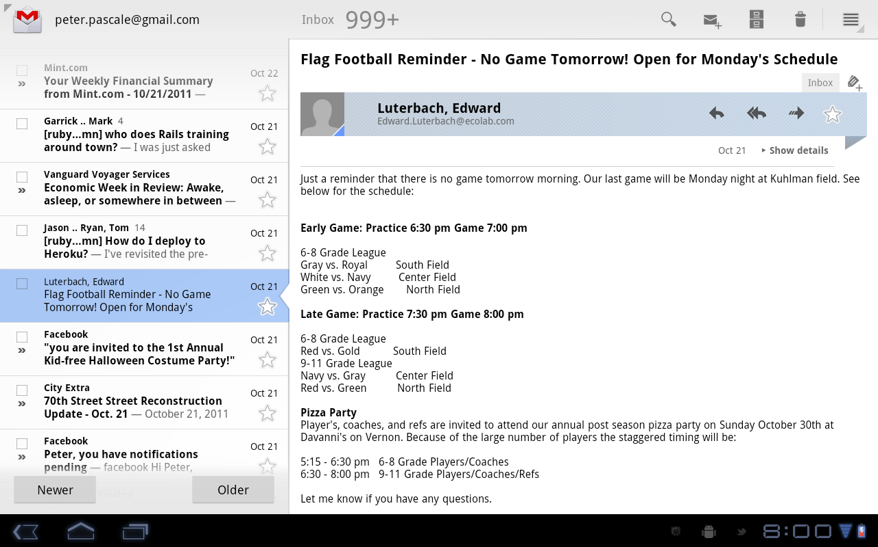
Multi-Pane Layout

Slide 29
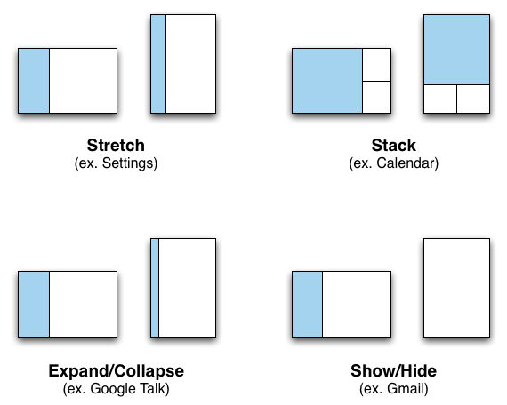
Multi-Pane Layout - Orientation Change
Preserve
Functional
Parity

Slide 30
Implementing Multi-Pane Layout
Fragments... The Building Blocks
The Resource System... The Dynamic Assembler
Backwards Compatibility Library... support 1.6+

Slide 31
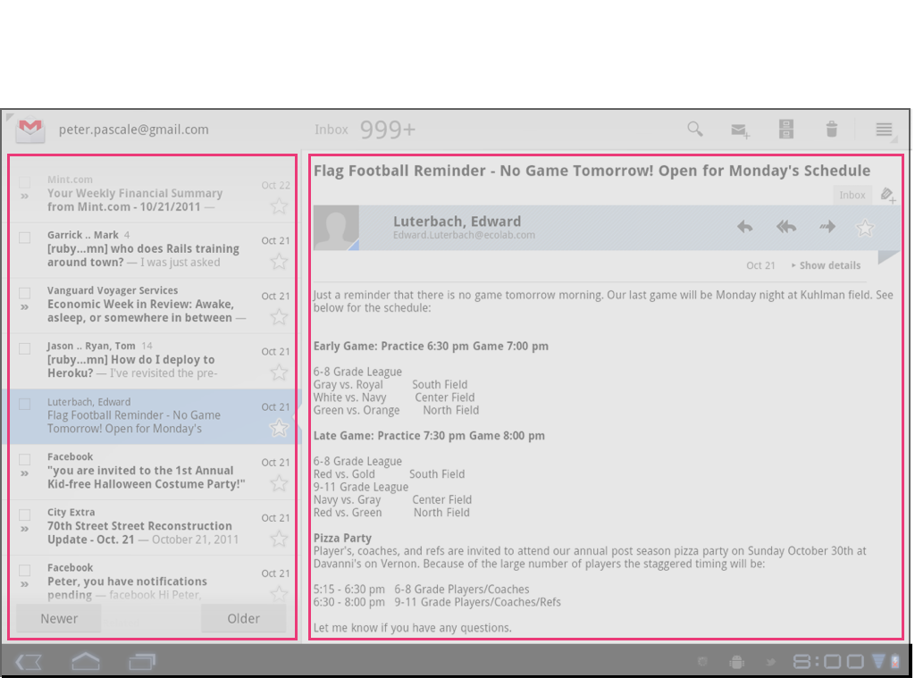
Fragments
Notes:
Peter
Android goal: Create a single APK (android exe) for both tablet and phone app.
Ambitious, but Android provides a number of facilities to support this.
First - Fragments
You can think of a fragment as a modular section of an activity, which has its own lifecycle, receives its own input events, and which you can add or remove while the activity is running.
You can combine multiple fragments in a single activity to build a multi-pane UI and reuse a fragment in multiple activities.

Slide 32
Fragments
Reusable Section of an Activity
Master
List Fragment
Detail Fragment
Notes:
Peter
Android goal: Create a single APK (android exe) for both tablet and phone app.
Ambitious, but Android provides a number of facilities to support this.
First - Fragments
You can think of a fragment as a modular section of an activity, which has its own lifecycle, receives its own input events, and which you can add or remove while the activity is running.
You can combine multiple fragments in a single activity to build a multi-pane UI and reuse a fragment in multiple activities.

Slide 33
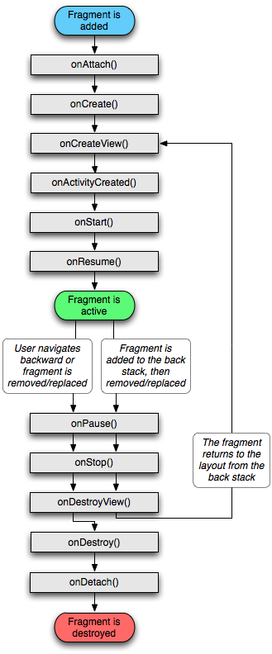


Fragment Basics
Behavior
Layout
.java
.xml
or programatic... or not at all...
Notes:
Fragment - represents a behavior or a portion of user interface in an Activity
Can combine multiple fragments in a single activity to build a multi-pane UI and reuse a fragment in multiple activities.
modular section of an activity,
which has its own lifecycle,
receives its own input events,
you can add or remove while the activity is running

Slide 34
Resource System Changes
Old Layout Categories - Since 1.6:
res/layout/my-layout.xml <-- Typical
Or
res/layout-land/my-layout.xml
res/layout-port/my-layout.xml

Slide 35
Resource System Changes
Honeycomb Layout Categories - 3.0 - 3.1:
Size small, normal, large, xlarge
Orientation port, land
Ex:
res/layout/my-layout.xml
res/layout-xlarge-land/my-layout.xml
res/layout-xlarge-port/my-layout.xml
Notes:
Peter
Honeycomb added new layout categories which you could combine with sizes.

Slide 36
Resource System Changes
Honeycomb Layout Categories - 3.0 - 3.1:
Size small, normal, large, xlarge
Orientation port, land
Ex:
res/layout/my-layout.xml
res/layout-xlarge-land/my-layout.xml
res/layout-xlarge-port/my-layout.xml
Deprecated

Slide 37
Resource System Changes
New Layout Categories - 3.2+:
Allows Specific Screen Size Designation - Not Just Categories
res/layout/main_activity.xml Phones
res/layout-sw600dp/main_activity.xml 7" Tablets
res/layout-sw720dp/main_activity.xml 10" Tablets
sw = Smallest Width
w = Available Min Width
h = Available Min Height
http://developer.android.com/guide/practices/screens_support.html
http://developer.android.com/guide/practices/screens_support.html#DeclaringTabletLayouts

Slide 38
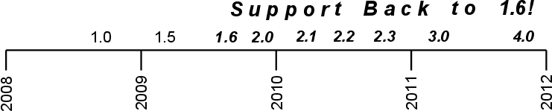
Backwards Compatibility Library
http://developer.android.com/sdk/compatibility-library.html

Slide 39
Multi-Pane Layout Code Demo
https://github.com/peterpascale/FragmentExample

Slide 40
Action Bar
Multi-Pane Layout
Carousel
Quick Actions
Dashboard
Workspaces
Notes:
Peter

Slide 41
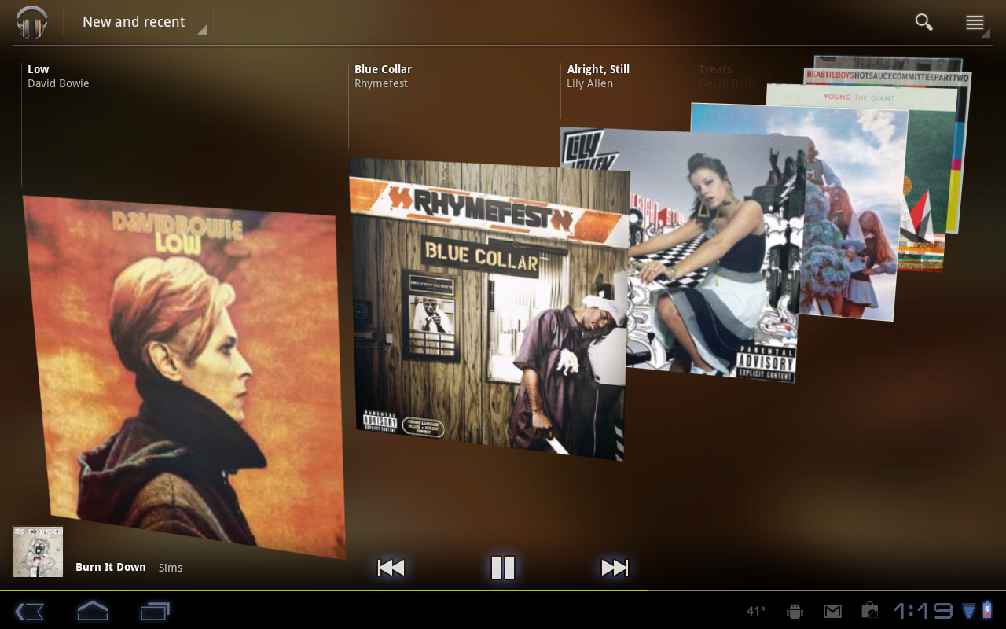
Carousel - "Beyond the List"
Break the Monotony of List Views

Slide 42
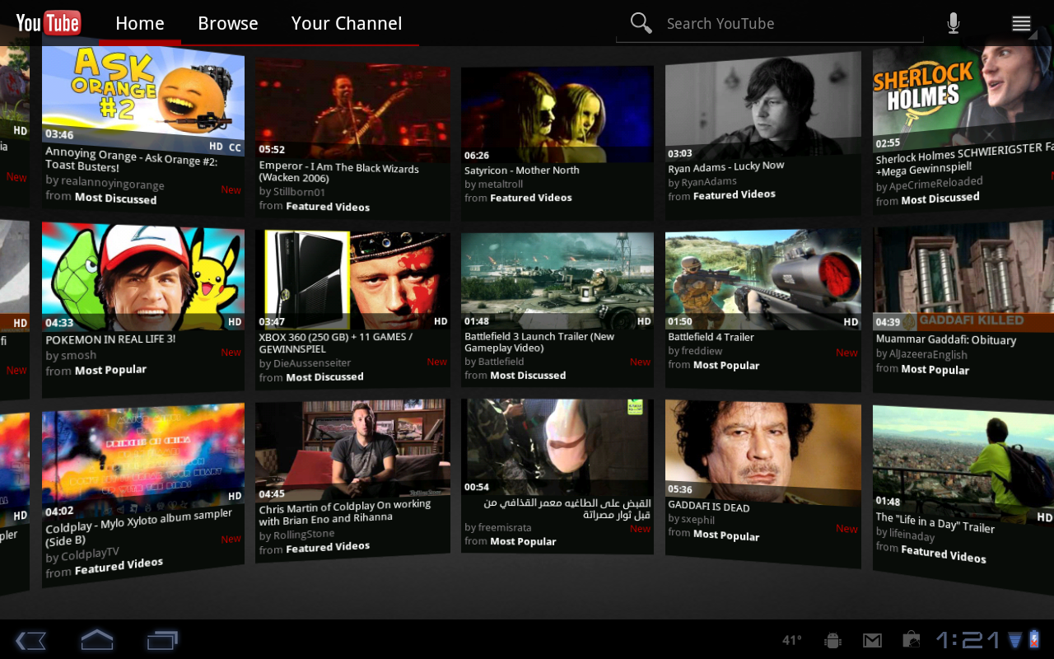
Carousel - "Beyond the List"
YouTube Video Wall

Slide 43
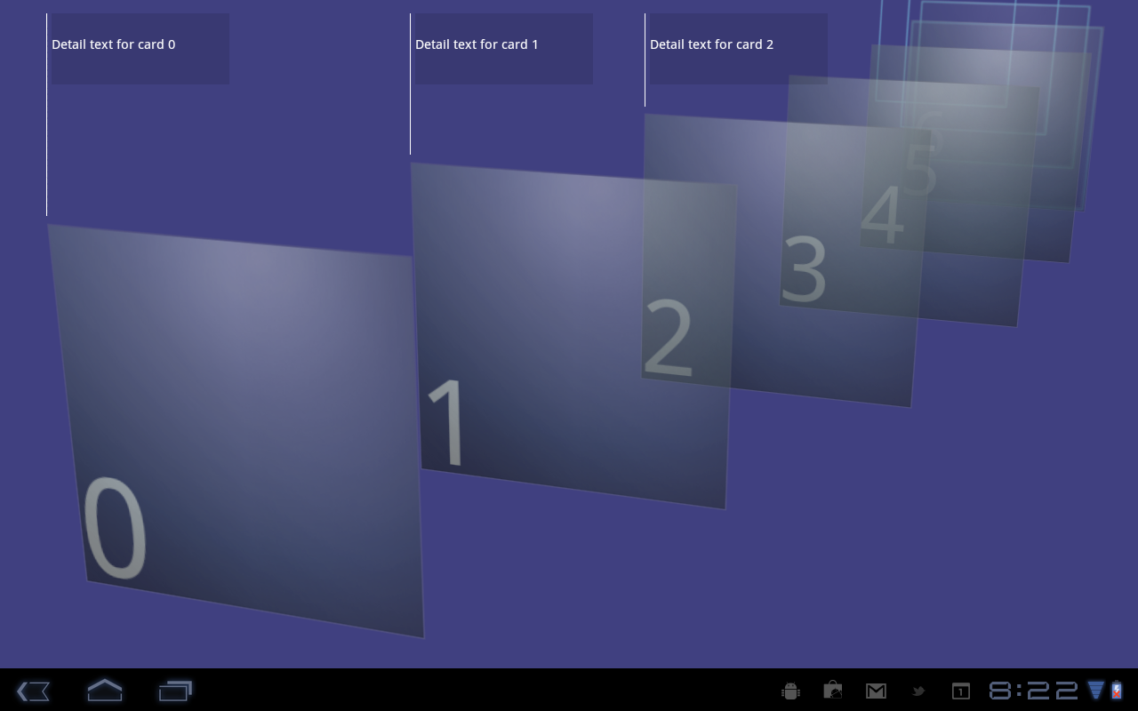
Carousel - Implementation
CarouselView
- Renderscript
- Ready for Customization
Gallery
- Single Items, Single Images
- Not Full Screen
http://j.mp/io2011-carousel-sample

Slide 44
Action Bar
Multi-Pane Layout
Carousel
Quick Actions
Dashboard
Workspaces
Notes:
Peter

Slide 45
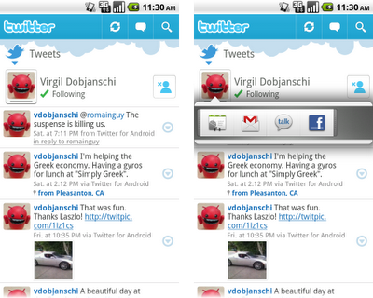
Quick Actions
Easy access to contextual actions
Practical even for limited real-estate
User easily sees context even when quick action is open

Slide 46
Action Bar
Multi-Pane Layout
Carousel
Quick Actions
Dashboard
Workspaces
Notes:
Vladan

Slide 47
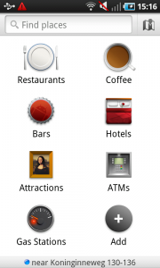
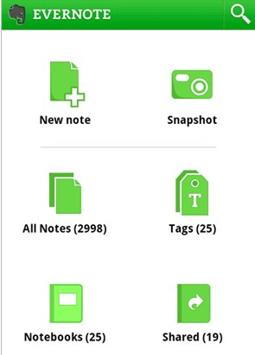
Dashboard
Good application entry point
Takes a lot of real estate
May appear that application has limited functionality
May be overwhelming to a new user

Slide 48
Action Bar
Multi-Pane Layout
Carousel
Quick Actions
Dashboard
Workspaces
Notes:
Vladan

Slide 49
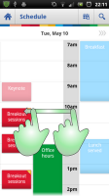
Workspaces
Useful when dealing with a lot of data
Clear navigation
Notes:
Vladan

Slide 50

Summary

Slide 51
Android UI Patterns
New Patterns
Problem
Solution
Since
Phone
Tablet
Action Bar
Access to most common actions
Horizontal action bar on top of the screen
3.0
Yes
Yes
Carousel
Engaging way to select options
scrolling 2D/3D carousel
3rd party
(3.0+)
Yes
Yes
Multi-pane Layout View
Provide effective use of large screens
Composite UI with reusable components
3.0
(with 1.6 compatibility)
No
Yes
Existing Patterns
Problem
Solution
Since
Phone
Tablet
Dashboard
Application home screen
Main brander landing page
Any
In Some Cases
No
Quick Action Menu
Provide contextual actions on a small screen
simple pop-up menu
3rd party
(2.0+)
Yes
In Some Cases
Workspaces
Displaying a lot of data on a small screen
horizontally scrollable tabs
Any
Yes
No
Notes:
Vladan/Peter
categorize the patterns into categories-new, relevant, dated
new patterns
- action bar
- multipane
- carousel
Still good
- dashboard
- busy indicator
- quick action menu
- workspaces
Not so good
- action drawer
- dynamic list - look what this is
-

Slide 52
Resources
http://en.wikipedia.org/wiki/User_interface_design
http://www.androiduipatterns.com/
http://momentummobile.com/mobile-app-ui-ux-design.html
http://developer.android.com/guide/topics/ui/declaring-layout.html
http://developer.android.com/guide/practices/screens_support.html
http://developer.android.com/guide/practices/ui_guidelines/icon_design.html
http://www.google.com/events/io/2011/sessions/designing-and-implementing-android-uis-for-phones-and-tablets.html
http://www.donnfelker.com/downloads/AndroidTabletDevelopment.pdf
http://developer.android.com/guide/topics/fundamentals/fragments.html
https://github.com/peterpascale/FragmentExample
http://j.mp/io2011-carousel-sample
Images
Android & Alien
http://www.flickr.com/photos/jdhancock/5138860024/
Roof
http://www.flickr.com/photos/45574318@N00/5370376951/
Android Pics
http://www.flickr.com/photos/lwallenstein/3870027760/sizes/m/in/photostream/

Slide 53


谢谢观赏
WPS Office
Make Presentation much more fun
@WPS官方微博
@kingsoftwps

